Slide 1


Slide 2
Get Started
Extract Zip
Invite 2-3 friends
Start VirusX
Have fun!
The Game requires .NET 4.0 and XNA4
A XNA4 Installer is contained in the Zip

Slide 3
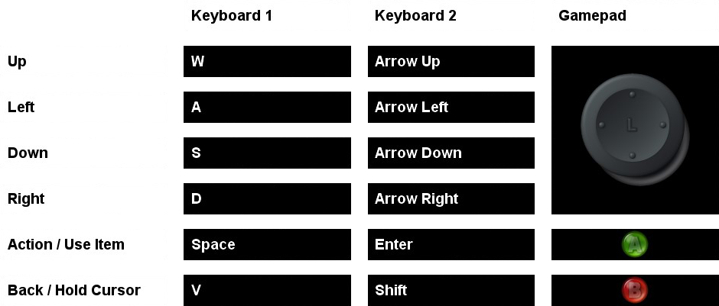
Controls

Slide 4
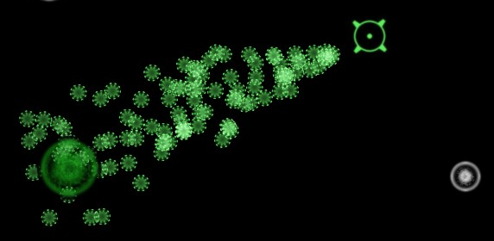
How to Play
Move your Viruses using your Cursor

Slide 5
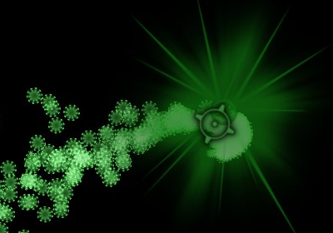
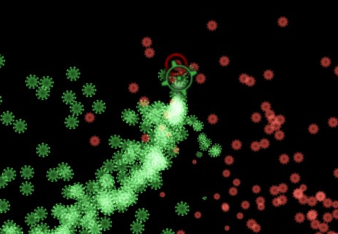
How to Play
Capture Cells by taking over Nuclei
Defeat your opponent’s Cells

Slide 6
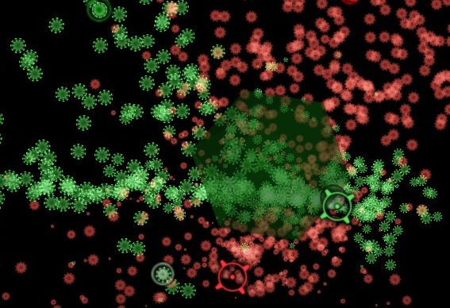
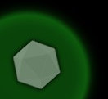
How to Play
Use Items!
Collected Items are shown in your corner

Slide 7




Objects
Gather Items!
Safe Zone - kills opponent’s Virus
Switch - possessions are shuffled
Wipe Out - nearly all Viruses die
Beware!
Anti Body - kills nearby Viruses

Slide 8
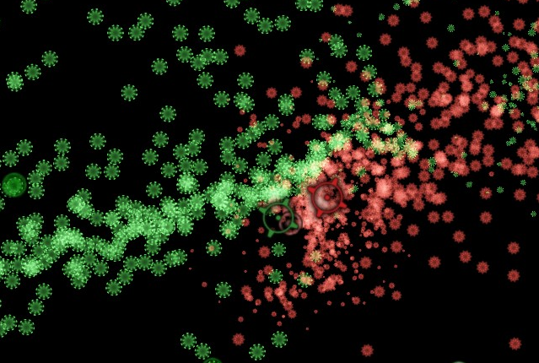
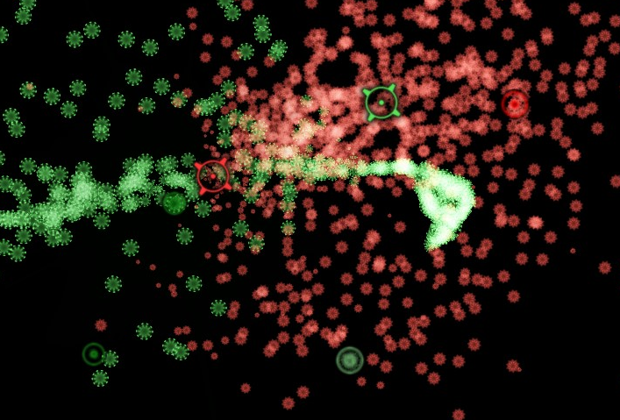
How to Win
Kill all enemy Viruses
Have fun!

Slide 9
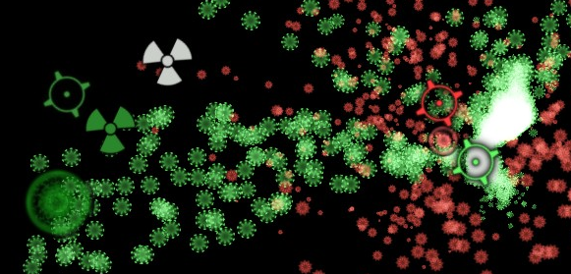
Advanced
Hold-Move to separate Virus-aim and Cursor

Slide 10

Thanks for playing
Andreas Reich
Enrico Gebert
Sebastian Lay
Maria Manneck

